Slide 1

Microfinance Trends
Made by Eugene Fotsing

Slide 2
Table of Content
Introduction
Problem Statement
Objectives
Questions
Data product
Data Ingestion
Data Wrangling
Exploratory Analysis
Challenges
Findings
Conclusion

Slide 3

Introduction
Microfinance refers to financial services, such as small loans, savings accounts, insurance, and financial education, provided to low-income individuals or small businesses who lack access to traditional banking services.
Creating multiple resources such as microfinance to assist them sometimes raises an issue of equity in the allowance of those services to the community.

Slide 4

Problem Statement
Loan Approval Predictability & Fairness:
- Assessing factors influencing approval
- Ensuring transparency & fairness in decision-making

Slide 5
Objectives
For this project, those are the objectives fixed for the analysis:
Identify key factors influencing loan approval
Assess the role of dept-to-income on loan decisions
Detect potential biases in loan Approval decisions
Predict loan approval outcomes using machine learning models
Analyze the influence of loan amount on approval rates

Slide 6
Questions
To guide the analysis, we come with the following preliminary questions:
What are the most significant factors that determine loan approval or denial?
Does the requested loan amount influence the likelihood of approval, and if so, to what extent?
Are there patterns of bias in loan approval decisions based on gender, age, location, or other demographic factors?
How does an applicant’s debt-to-income (DTI) ratio affect their chances of loan approval?

Slide 7

Data Product
The Proposed Data Product is :
Web/App tool for loan approval predictions providing approval probability & key influencing factors

Slide 8

Data Source overview
The data source used for this microfinance project is FICO Score Data. The organization responsible for collecting those data is called FICO.
FICO is a pioneer company in the development of credit scoring systems since 1956.
They collect data from its collaboration with major credit bureaus and other financial institutions. The company regularly updates its models and collects data each year.

Slide 9
Purpose & Data Topic
The data collected is to assess the credit risk of individuals and businesses. This helps lenders make more informed decisions regarding loan approvals, interest rates, and credit limits.
The topic of those data could be about: Credit Scores, Loan and Credit Information, Behavioral Data, and Demographic Data.

Slide 10
Data Set Overview
For this project, the year chosen for the analysis is 2023.
The original data set used for the project has 617,996 instances and 27 features

Slide 11
Wrangling Process
For my analysis of the approval of loans, I considered several factors such as: ID, ethnicity, race, gender, outcome, loan amount, loan to value ratio, debt to income ration, income, etc.
The data set did not contain duplicates, but rather filling values such as: 9999, 8888, 1111, NA, Exempt, Free from text Only, etc.
To avoid skewed the result of my analysis, I decided to get rid of any row that contains any of those filling's values.

Slide 12
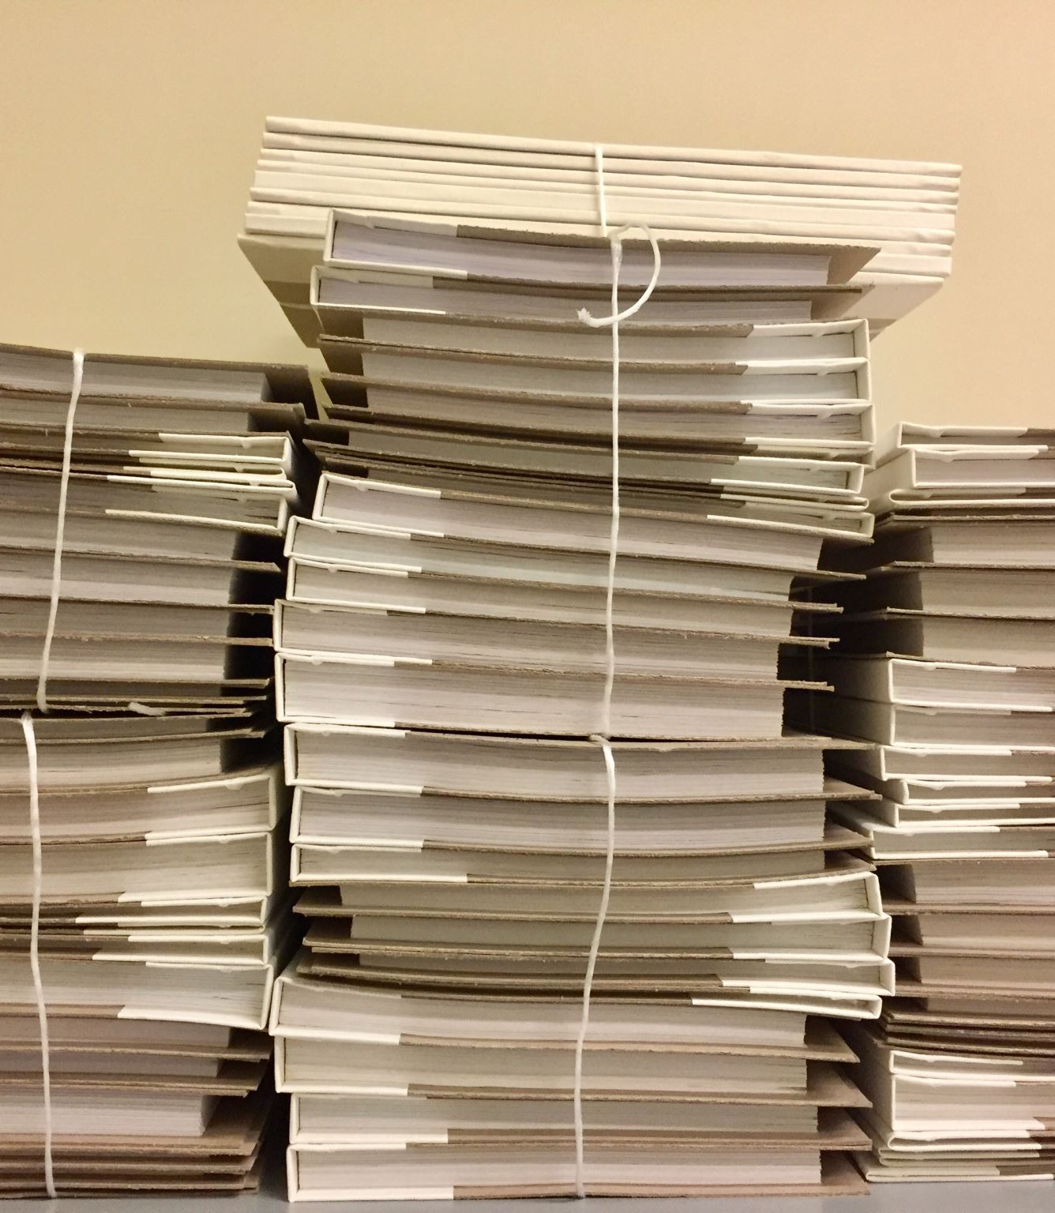
Cleaning process
To wrangling the data set, I proceed to Removed invalid/missing values then Standardized & imputed missing data
The result of the cleaning make us end with a data set of 315,416 instances and 14 features.
I remove a total of 302,580 rows during the cleaning process.

Slide 13
Exploratory Data Analysis
After the wrangling process, it appeared to see that the data set contains several missing values. To mitigate that issue, a missing analysis have been conducted to see patterns inside the missing values and find a way to fix them.
Multiple features on the data set suffered from missing data such as :
Race
Gender
Debt to income ratio
Income
Applicant and co-applicant age

Slide 14

Imputation
To fix several features of the dataset, I proceed to impute some statistical values to replace missing values
To solve the missing values of the race feature, since all the values of the feature are nominal, I replace all missing values with the Mode of the race.
The same process is used to solve missing values on the age feature for both the applicant and co-applicant
The same goes for the income, at the difference of the nature of values I use the mean to replace missing values (zeros, N/A)

Slide 15

Feature Engineering
Overcoming the missing values of the debt-to-income ratio (DTI) require me to recalculate the whole values only for missing values using the income and loan amount as variable using the formula:
DTI = ( total debt / gross income) * 100
After the new values calculated, they will add to the data set. Most of the original values are bin values, to make it easier for analysis I map those bin into numeric values by using the midpoint between the bin
Then create a new feature call DTI numeric to store the mapping values as long as the recalculated DTI values.

Slide 16
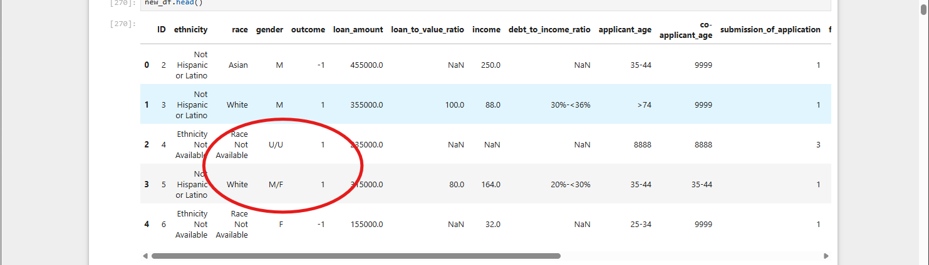
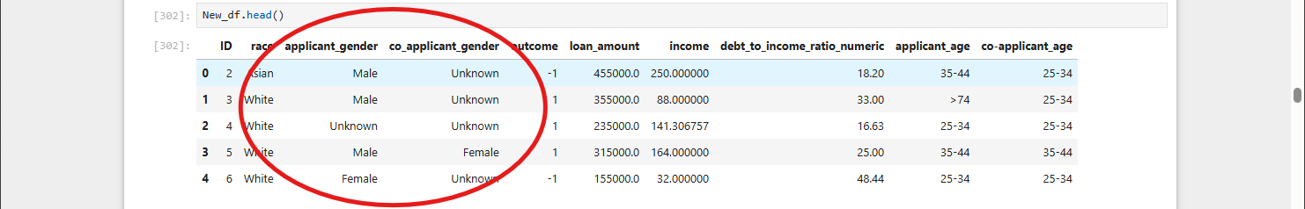
Another feature engineering was the creation of two gender feature to replace the original model.
I create a function to split the format an attribute respective gender to each new feature applicant gender, co-applicant gender

Slide 17
Refine Work
After refining the data set and fixing missing values, I had come to review the data questions that I will be answering during the remaining of the analysis:
At what threshold does the debt-to-income (DTI) ratio become a deciding factor?
How does loan amount variation impact approval chances across income levels?
What are the top three factors influencing loan approval decisions?
Do gender, or race affect loan approval rates significantly?

Slide 18

Factors & Data set
For the remaining of the analysis, I will be using the totality of instances (617995) and 10 features:
ID
Race
Outcome
Gender (applicant & co-applicant)
DTI
Income
Loan Amount
Applicant age
Co-applicant age

Slide 19
Challenges
During this analysis on loan approval in microdata, I encounter several challenges such as:
Finding data set for the project
The considerable amount of missing values
The numbers of adjustment needed to not skewed the analysis results
The size of the data set.

Slide 20

Findings and Trends

Slide 21
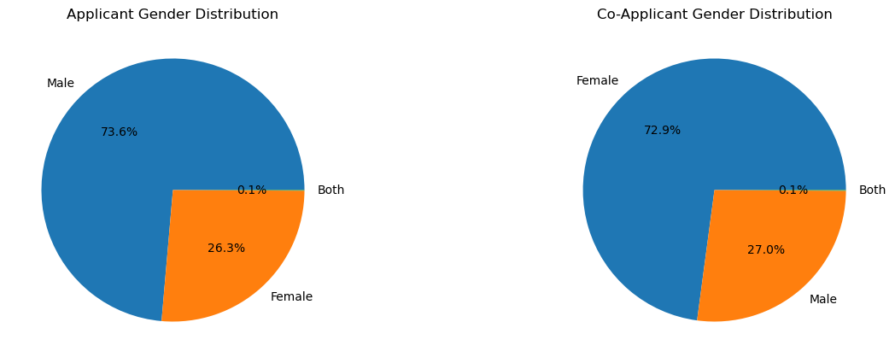
Gender Distribution by applicant/Co-applicant
During the loan application process more than 70% of applicant and co-applicant are respectively Male & Female
Notes:
The correlation between the outcome and be the applicant is 0.025426. On the other side the correlation between the outcome and be the co-applicant is -0.781449

Slide 22
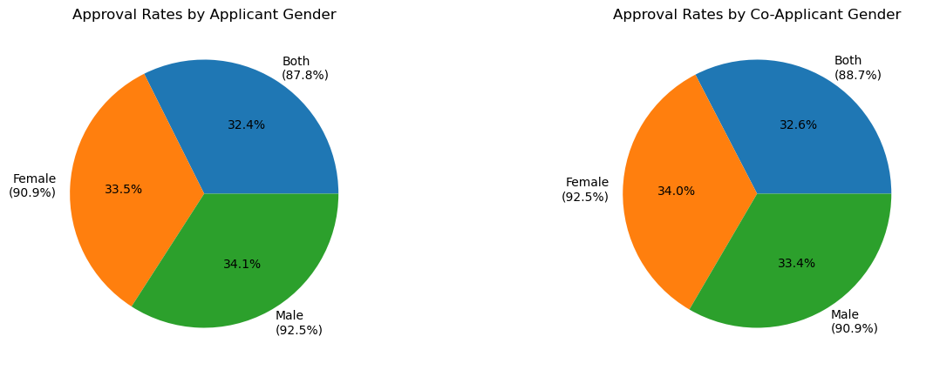
Approval Rate by Gender
The combination that has the most approval rate (94.3%) for loan is Female & Female

Slide 23
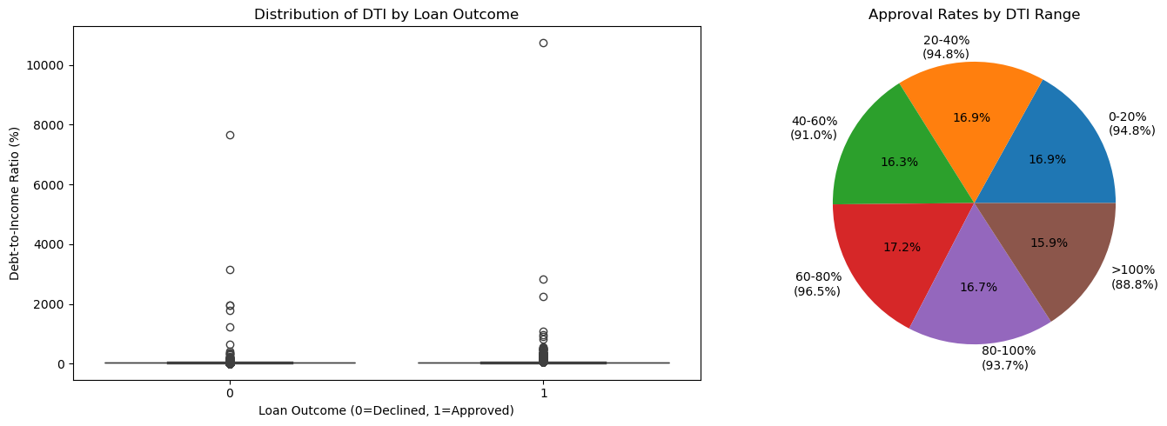
Correlation & Distribution of DTI of loan Approval
The average DTI range to be approved for loan is 60-80%
The correlation between the DTI and the outcome is to : -0.0482

Slide 24
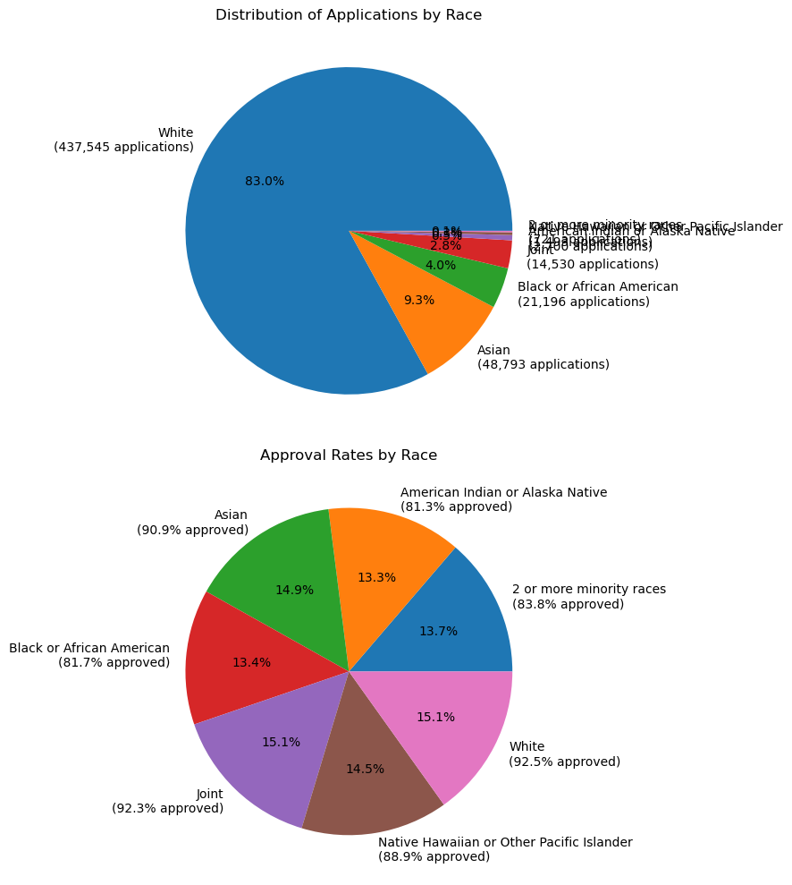
Race Distribution on Approval Rate
The race with the Highest approval rate is White with a rate of 92.5%
The overall approval rate is 90.8%
Percentage Points Difference from Overall Approval Rate:
Joint: +0.4 percentage points
Asian: -0.9 percentage points
Native Hawaiian or Other Pacific Islander: -2.9 percentage points
2 or more minority races: -8.1 percentage points
Black or African American: -10.1 percentage points
American Indian or Alaska Native: -10.5 percentage points

Slide 25
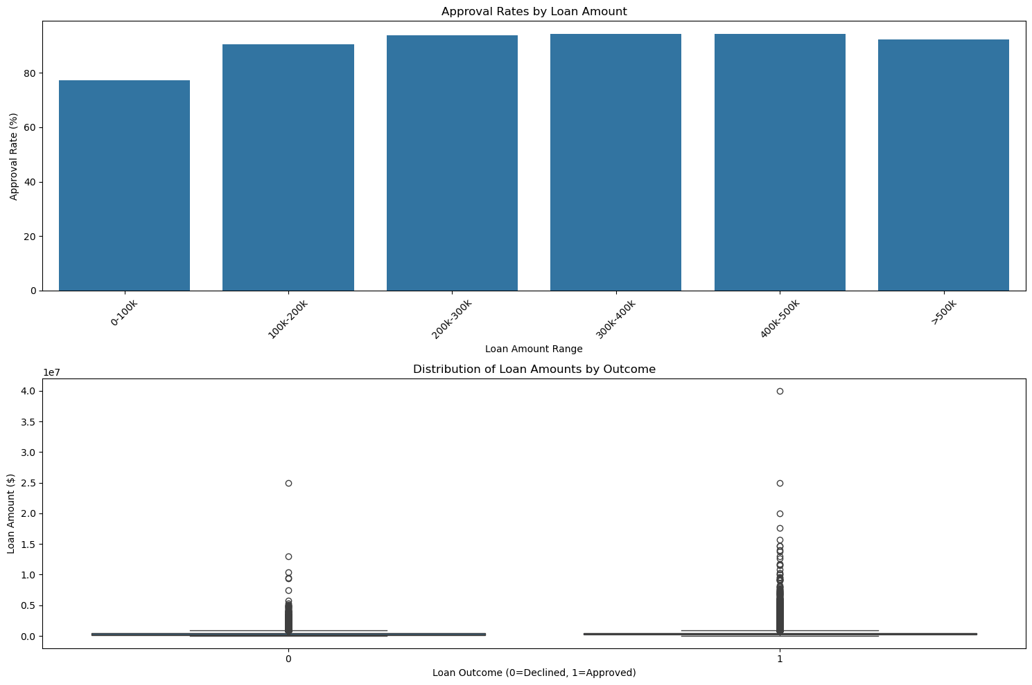
Loan Amount influence on loan approval Rate
I evaluate the approval percentage by loan amount range.
The loan amount range with the highest approval is 400K-500K with a percentage of 94.3 %

Slide 26
The correlation between Outcome and Loan Amount: 0.0325

Slide 27
Conclusion
The purpose of the analysis was to study the trends of the loan approval process
The analysis study the correlation different factors (race, loan amount, DTI, etc.) that influence the outcome of the loan process.

Slide 28
Data Insights
During this project, I learned several techniques such as imputation using statistical values.
New feature engineering process using existing features.
If I would have time, I would have implemented machine learning (ML) and do some predictions by combining the top factors of loan approval.

Slide 29

Thank for Listening

